Slide 1

Deploying Microsoft Azure Stack Hub
Microsoft Azure Stack Hub Architecture
This work is licensed under a Creative Commons Attribution - ShareAlike 4.0 International Public License

Slide 2
Agenda
Architecture overview
Capacity, scalability, and resiliency
Compute
Networking
Storage

Slide 3
Delivering Azure Stack Hub as an integrated system
Software
Hardware
Support
Services

Slide 4
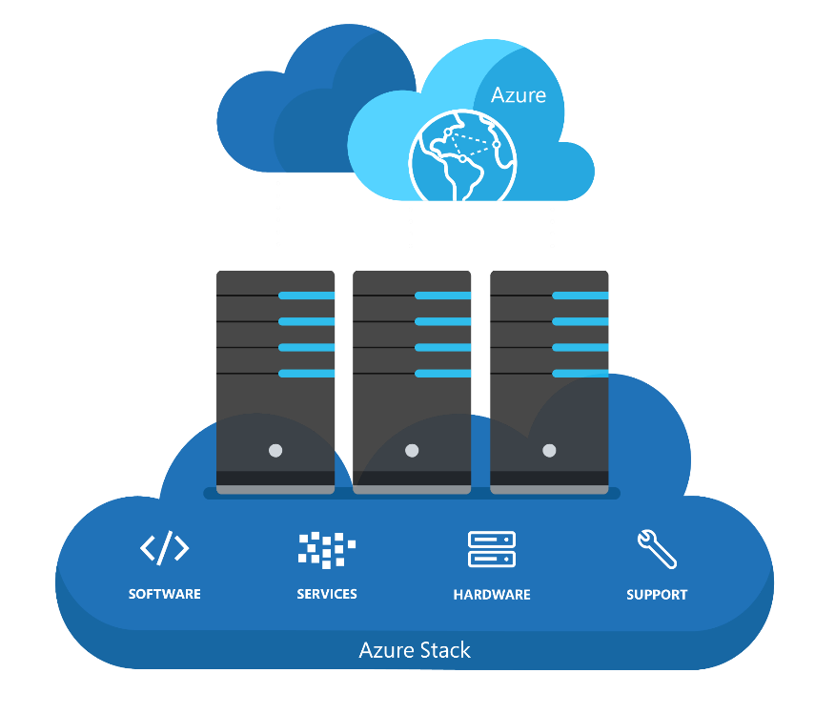
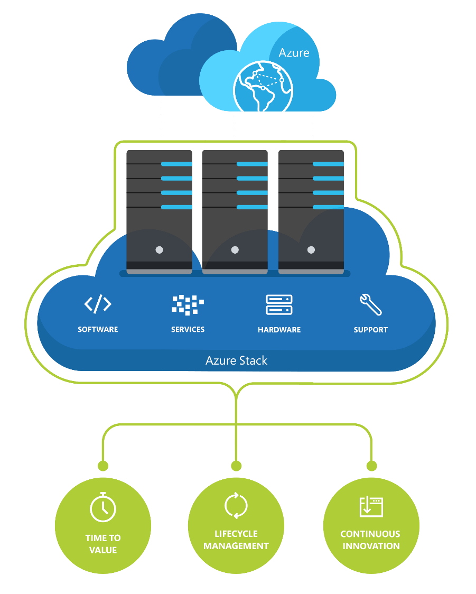
Azure Stack Hub integrated systems
...….
….
….
Accelerated time to value
From concept to operations in days, not months
Help developers be productive much faster
Enriched lifecycle management
Greater quality and system reliability
Focus on delivering Azure services, not operations
Continuous innovation
Newest services and fastest updates
Minimize disruption to user availability/experience

Slide 5

Azure Stack Hub integrated system
Software
Hardware
Support
Services
Architecture, hardware, and topology
Deployment, configuration, provisioning
Validation
Monitoring, diagnostics
ToR Switch
ToR Switch
BMC Switch
Azure Stack Hub
integrated system
Security and privacy
Business continuity
Patching and updating
Field replacement of parts
Server
Server
Server
Server

Slide 6
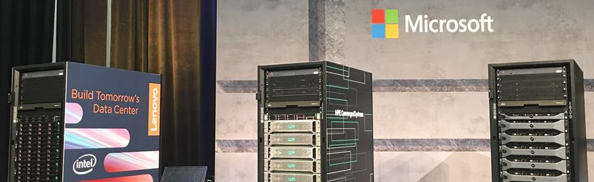

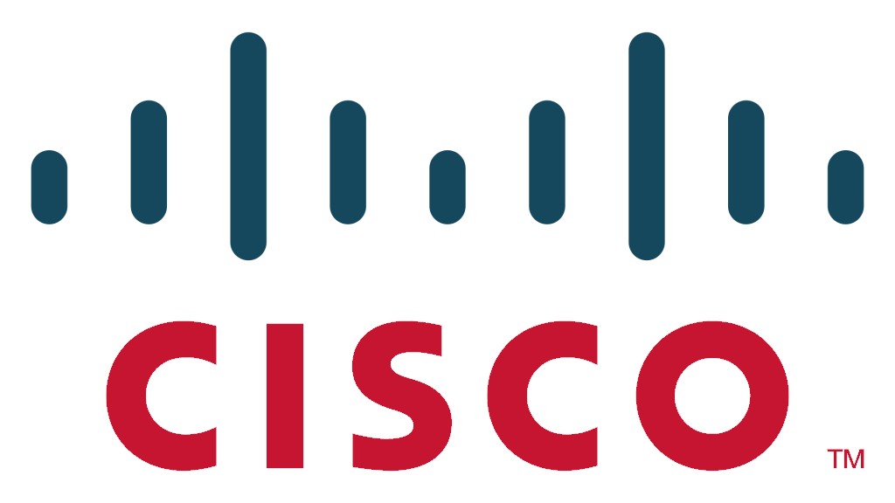




Azure Stack Hub integrated systems

Slide 7
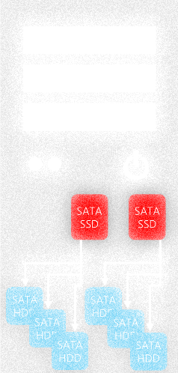
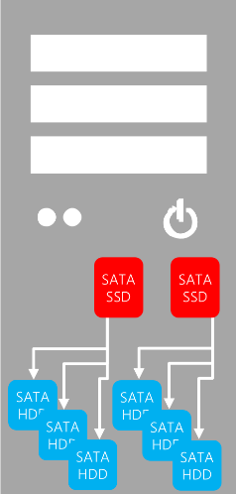
Azure Stack Hub minimum hardware requirements: Servers
Compute
CPU: 20 Cores Minimum (2 socket @ 10 cores each)
256GB Memory Minimum
NIC – 2 port 10 GbE or better
Boot Device 400GB or larger (optional mirroring)
Storage
2+ Flash Devices
(NVMe, SATA SSD or SAS SSD)
Ratio** of
Cache to Capacity
10%
4+ Capacity Devices
(HDD or SSD)
** Cache capacity should accommodate intended workload.
If Spaces Direct cache devices are used in the solution, the capacity will align with the devices’ resiliency or drive-writes-per-day capabilities. The OEM will provide more details of their solutions’ capabilities for caching
2 Power Supplies

Slide 8

Azure Stack Hub integrated system (lifecycle)
Architecture, hardware, and topology
Deployment, configuration, provisioning
Validation
Monitoring, diagnostics
Security and privacy
Business continuity
Patching and updating
Field replacement of parts

Slide 9
Azure Stack Hub hardware requirements: Network switches*
Top-of-rack switches
2 switches per scale unit, configured for resiliency
10 GbE or better for server connectivity
Support for BGP, DCB, PFC, ETS, and Multi-Chassis Link Aggregation
BMC / management network switch
1 GbE switch capable of L3 routing and simultaneous connectivity to the ToRs
*Single scale unit

Slide 10
Azure Stack Hub architecture overview

Slide 11

Cloud operating model
operate
use
Azure
Azure customers
Microsoft engineers
use
operate
Azure Stack Hub instance
Your customers
Your engineers
Cloud Architect – Design
Cloud Operator – Operate Azure Stack Hub

Slide 12
Infrastructure software – What runs where?
Appliance-like architecture and deployment
Servers: Windows Server 2016
Compute / Storage / Network
All infrastructure roles are hosted in VMs
Resiliency, scalability, change in features
VMs get re-deployed during patch and update (replace instead of patch)
These VMs run Windows Server 2016
Azure Stack Hub customer and cloud administrator
Tenant and Admin Portal

Slide 13
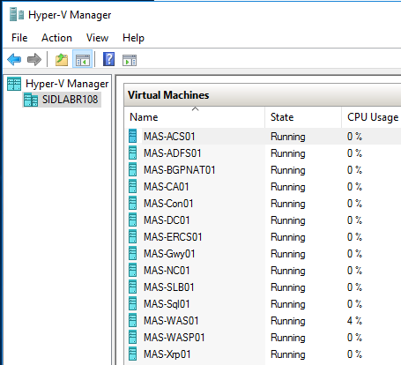
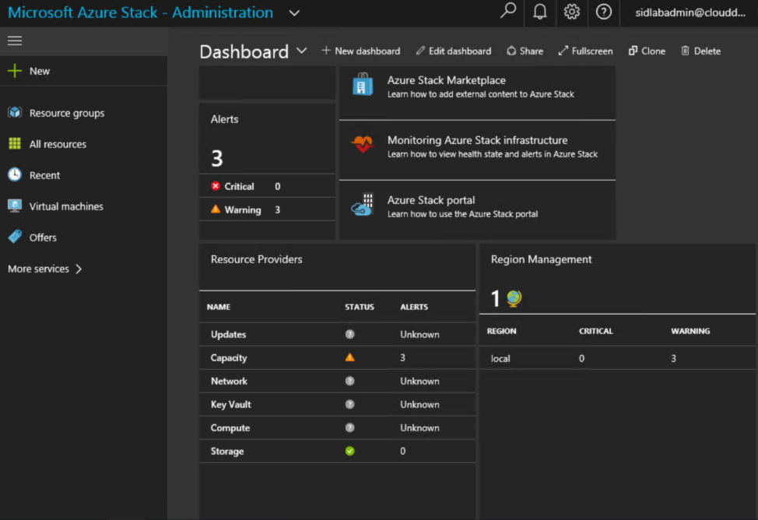
I’m an admin, what’s my focus?
https://adminportal.local.azurestack.external
Traditional Virtualization Management
Cloud-based Management
Management of Azure Stack Hub is performed within the portal and cannot be managed like traditional virtualization platform solutions

Slide 14
Azure Stack Hub core infrastructure roles
Role Name | components or services description
AzS-ACS01 | Azure Stack Hub storage services.
AzS-ADFS01 | Active Directory Federation Services (ADFS).
AzS-BGPNAT01 | Edge router and provides NAT and VPN capabilities for Azure Stack Hub. (only for ASDK)
AzS-CA01 | Certificate authority services for Azure Stack Hub role services.
AzS-DC01 | Active Directory, DNS, and DHCP services for Microsoft Azure Stack Hub.
AzS-ERCS01 | Emergency Recovery Console VM.
AzS-GWY01 | Edge gateway services such as VPN site-to-site connections for tenant networks.
AzS-NC01 | Network Controller, which manages Azure Stack Hub network services.
AzS-SLB01 | Load balancing multiplexer services in Azure Stack Hub for both tenants and Azure Stack Hub infrastructure services.
AzS-SQL01 | Internal data store for Azure Stack Hub infrastructure roles.
AzS-WAS01 | Azure Stack Hub administrative portal and Azure Resource Manager services.
AzS-WASP01 | Azure Stack Hub user (tenant) portal and Azure Resource Manager services.
AzS-XRP01 | Infrastructure management controller for Microsoft Azure Stack Hub, including the Compute, Network, and Storage resource providers.

Slide 15
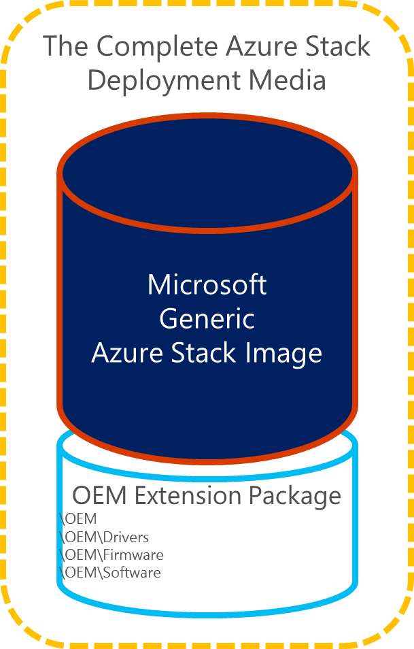
Hardware lifecycle host (HLH)
Definition
A server connected to the BMC Network that is external to the Azure Stack Hub environment
Available to run partner’s lifecycle management software within VMs
Purpose
Hardware monitoring software
Firmware configuration and update software
Emergency management and hardware troubleshooting
Running the Azure Stack Hub Deployment Virtual Machine (DVM) for the duration of initial deployment
Configuration
Network connection to the BMC switch
Windows Server 2016 Standard or Datacenter Edition
Enabled with Hyper-V role
Meets Azure Stack Hub security requirements

Slide 16


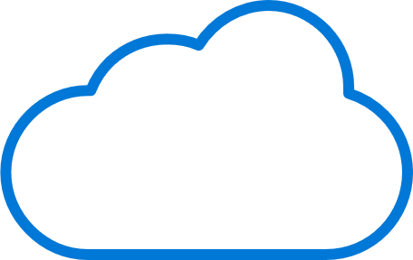
Azure Stack Hub concepts
Scale Unit
Region
Cloud
Associated with a single Region
1 or more Scale Units within a Region
Unit of capacity expansion
4 or more servers within a scale unit
Fault domains (Azure consistency)
Alignment of Hardware SKU – which is homogenous within Scale Unit
Set of Scale Units that share same “physical location”
Under one physical and logical “administrator”
Networking requirements
High-bandwidth/low latency
Flat, layer-3 network
Other attributes are implied by customer choices
Scale unit may have different type of hardware from same vendor
Single instance of Azure Resource Manager (ARM)
1 or more Regions under management of ARM
Supports different hardware vendors across multiple regions

Slide 17
Border
Device
Scale Unit
ToR Switch
ToR Switch
BMC Switch
Server
Server
Server
Server
HLH

Slide 18
Border
Device
Multiple scale units is still a FUTURE planned capability for Azure Stack Hub. Not available now.
Scale Unit 1
Scale Unit n
Spine Switch
Spine Switch
ToR Switch
ToR Switch
ToR Switch
ToR Switch
BMC Switch
BMC Switch
Server
Server
Server
……….
Server
Server
Server
Server
Server
Region
Cloud

Slide 19

Integration in your datacenter
Border
Device
Datacenter monitoring/ticketing/
hardware monitoring
Scale Unit 1
Scale Unit n
Aggregate Switch
Aggregate Switch
ToR Switch
ToR Switch
Identity Integration
(Tenant & Cloud Admin)
ToR Switch
ToR Switch
BMC Switch
BMC Switch
Server
Server
Space, Power,
& Cooling
Server
……….
Server
Server
Server
Server
Server

Slide 20
Azure Stack Hub capacity, scalability, and redundancy

Slide 21
Azure Stack Hub: Inputs to capacity planning
Servers
Cores
Memory
Storage devices (capacity)
NIC performance
Storage performance
Infrastructure use (VMs + software update)
Application behaviors

Slide 22
Azure Stack Hub scale unit
Tenant Capacity
Patch and Update Reserve
Infrastructure Services
Server
Server
Server
Server

Slide 23
Azure Stack Hub scale unit – Adding server nodes…
Tenant Capacity
Tenant Capacity
Note – Servers can be added individually up to 16 nodes per scale unit
Patch and Update Reserve
Infrastructure Services
Server
Server
Server
Server
Server
Server
Server
Server

Slide 24
Azure Stack Hub Compute

Slide 25
Compute
Azure Resource Manager
vNICs, …
VMs, VM Extensions, Platform Images
Storage Accounts
Blobs, Tables, …
Compute Resource Provider
Azure Guest Agent
Hyper-V Clusters
Networking
Compute
Storage

Slide 26
VM sizes on Azure Stack Hub
Azure Stack Hub supports a subset of VM sizes
Currently we have support for A, D, DS and F
Emulation is imperfect and is focused on uniform in-guest quantities
RAM, CPU, Disk size quantities are aligned to Azure
Storage performance is likely to be significantly better than Azure
CPU performance is better than Azure for low-load environments
CPU performance is non-deterministic for a given VM size (A VM size may run faster than a Dv2)
Entry level
A
Av2
General Purpose
D
Dv2
DS
DSv2
Compute Intensive
F
Fv2
FS
FSv2
Virtual machine sizes supported in Azure Stack Hub
https://docs.microsoft.com/en-us/azure/azure-stack/user/azure-stack-vm-sizes

Slide 27
Azure Stack Hub Networking

Slide 28
Networking
Azure Resource Manager
vNICs, GWs, SLBs, vNets, ACLs…
VMs, VM Extensions, Platform Images
Storage Accounts
Blobs, Tables, …
Network Resource Provider Network Controller Software Load Balancer
Data Plane vSwitch, Gateway
Networking
Compute
Storage

Slide 29
Physical network switch topology
Two connectivity types in Azure Stack Hub
DATA (Windows Server 2016 Converged NIC: SDN + Storage)
BMC (Physical host control + 3rd party hardware monitoring)
Resiliency is built in
DATA – Single physical NIC with dual ports (minimum 10Gb+)
Uses switch-embedded-teaming (WS2016) for port/link resiliency
Assumes dual-switch (ToR) configuration

Slide 30
Network switch connectivity – within scale unit
ToR-to-ToR
MLAG
ToR Switch
Switch Management
ToR Switch
Server – Port A
BMC Switch
Server – Port B
BMC – Server Management
Server
Server
Server
Server

Slide 31
Network switch connectivity – between scale units
Aggregate Switch
Aggregate Switch
ToR Switch
ToR Switch
ToR Switch
ToR Switch
BMC Switch
BMC Switch
Server
Server
Server
Server
Server
Server
Server
Server

Slide 32
Azure Stack Hub Storage

Slide 33
Storage
Azure Resource Manager
SLB, …
VMs, VM Extensions, Platform Images
Storage Accounts
Blobs, Tables, …
Storage Resource Provider Blob Service, Table Service, …
Scale Out File Server Storage Spaces Direct, ReFS
Networking
Compute
Storage

Slide 34
Azure-consistent storage
Delivers Azure-consistent Blobs, Tables, and Storage accounts
Comprehensive private cloud service provider manageability
Deployable in either enterprise-private clouds or hosted public clouds from service providers
IaaS storage (Page Blobs), and PaaS storage (Block Blobs, Tables)
Highly-reliable, resilient, and scalable cloud storage based on standard hardware
For Tenant
For Administrator
Azure-consistent blob service
Azure-consistent table service
Azure-consistent account service
Azure Stack Hub storage cloud admin service
Microsoft Azure Stack Hub w/ SRP
SMB3 Storage Network Fabric
Blob back-end
Scale-Out File Server (SOFS)
Blob back-end
. . . . .
Storage Spaces, Storage Spaces Direct (S2D), or SAN
Physical Storage

Slide 35
Storage stack
Storage Spaces
Single scalable pool with all disk devices (except boot)
Multiple virtual disks per pool (Mirrored)
Software Storage Bus
Storage Bus Cache
Leverages SMB3 and SMB Direct
Servers with local disks
SATA, SAS, and NVMe based on OEM SKU
Virtual Machines
CSVFS Cluster File System
ReFS On-Disk File System
Storage Spaces Virtual Disks
Storage Spaces Storage Pool
Software Storage Bus

Slide 36
Built-in cache
Cache is an integral part of Software Storage Bus
Scoped to local machine
Agnostic to storage pool and virtual disks
Automatic configuration when enabling Spaces Direct
Cache behavior is dependent on type of operation
SATA
SSD
SATA
SSD
Caching devices
SATA
HDD
SATA
HDD
SATA
HDD
SATA
HDD
Capacity devices
SATA
HDD
SATA
HDD

Slide 37
Azure Stack Hub volumes
Mirror spaces have resiliency granted from multiple data copies
Like Azure, data has three copies in Azure Stack Hub
Azure Stack Hub leverages a 3-way mirror
Normal mirror sets can survive the loss of a single physical disk
Azure Stack Hub 3-way mirror can survive the loss of two physical disks
Category | Detail
Volume type | Mirror
Optimized for | Performance
Use case | All data is hot
Efficiency | Least (33%)
File System | ReFS

Slide 38
Azure Stack Hub storage
Virtual Disks
Infrastructure
Temp Storage (one per server)
Tenant (logically – one per server; managed by ACS)
Add a Server
Add one Temp Storage virtual disk
Add one Tenant virtual disk
Mirrored (3-way for Infrastructure and Tenant) Physical Devices
2 or more Storage Spaces Direct cache devices
4 or more Storage Spaces Direct capacity devices

Slide 39
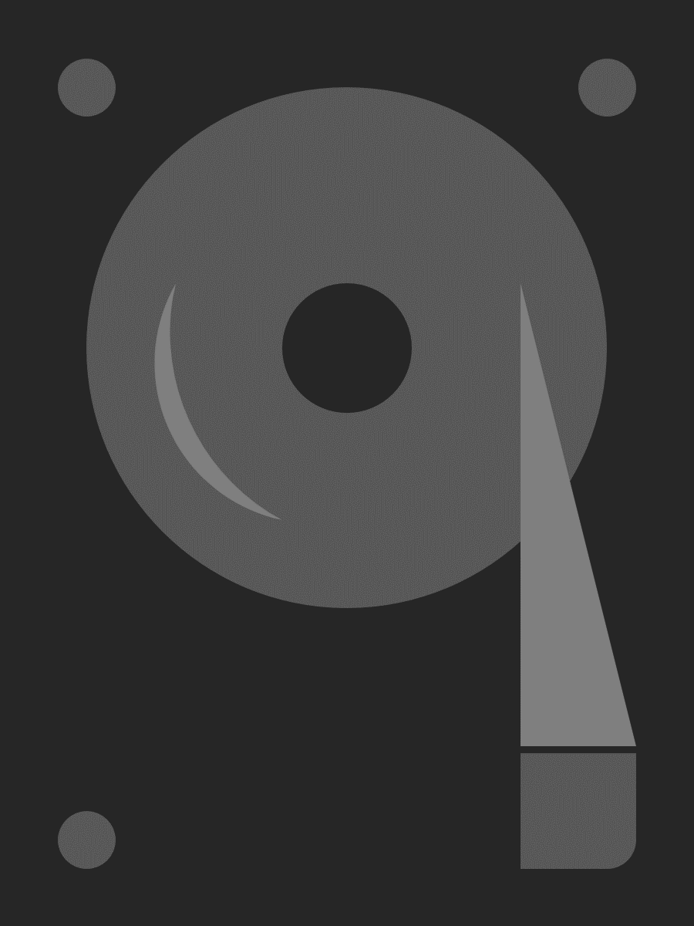
Azure Stack Hub storage redundancy
In Storage Spaces Direct for Azure Stack Hub, the default is to keep three copies of the data split between three server nodes
Azure Stack Hub VMs are clustered and split across three nodes
Three copies of all data written to disk
This means you can lose a whole server due to failure or during patch and update and still have 2-copy redundancy
256 MB #0019
COPY #0023
256 MB #0024
COPY #0021
COPY #0019
256 MB #0021
COPY #0020
256 MB #0022
COPY #0024
256 MB #0020
COPY #0022
256 MB #0023
COPY #0015
256 MB #0017
256 MB #0014
COPY #0013
256 MB #0015
COPY #0016
256 MB #0018
COPY #0014
256 MB #0016
COPY #0017
256 MB #0012
COPY #0018
256 MB #0011
COPY #0005
COPY #0010
256 MB #0008
COPY #0009
COPY #0012
256 MB #0010
COPY #0006
COPY #0011
256 MB #0009
COPY #0008
256 MB #0013
256 MB #0001
256 MB #0002
COPY #0003
COPY #0007
256 MB #0004
256 MB #0007
COPY #0002
256 MB #0003
256 MB #0005
COPY #0001
256 MB #0006
COPY #0004
Server 1
Server 2
Server 3

Slide 40
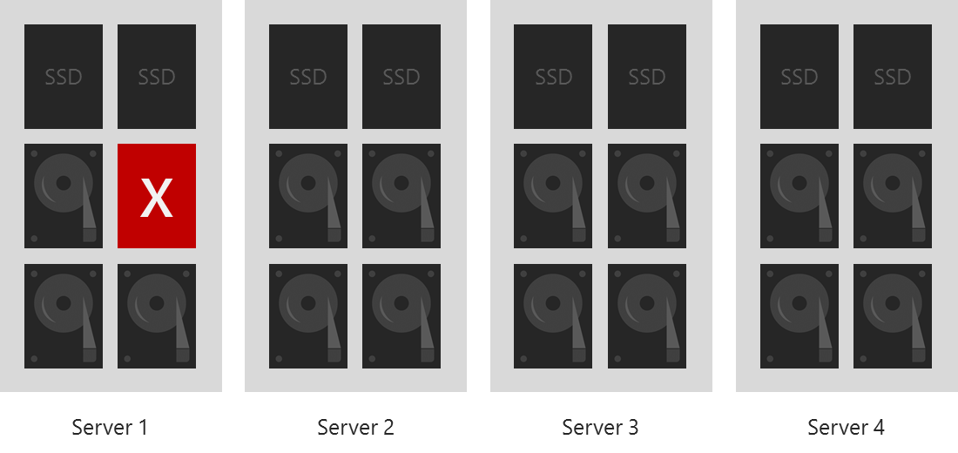
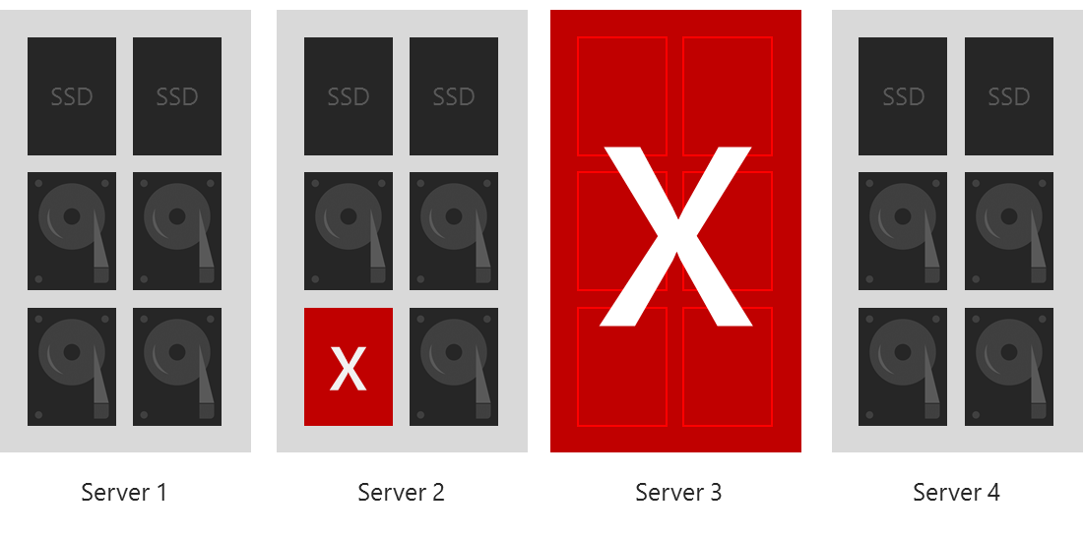
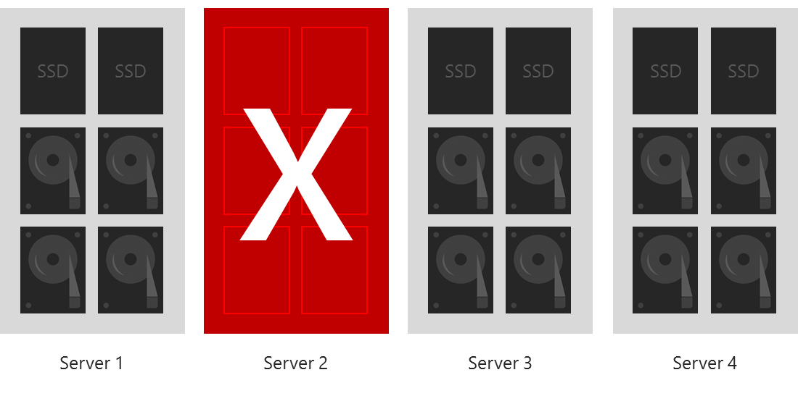
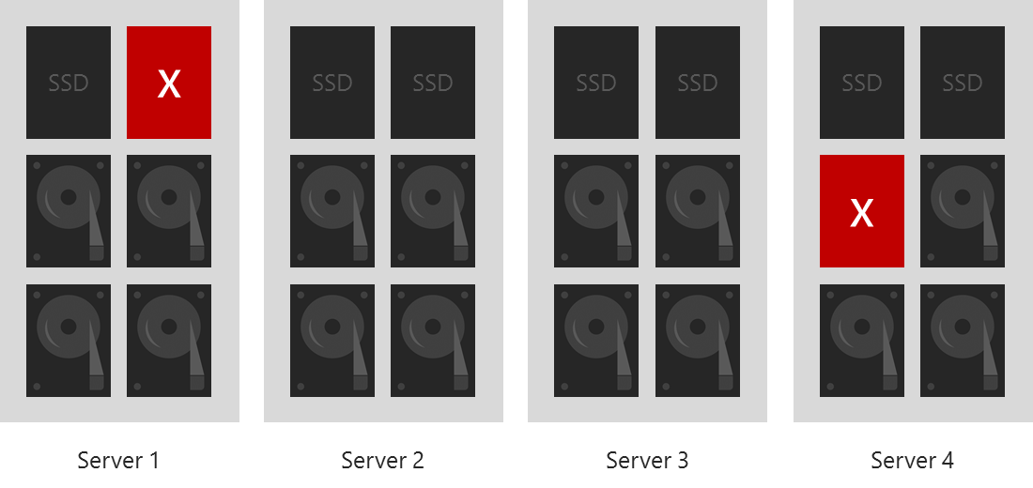
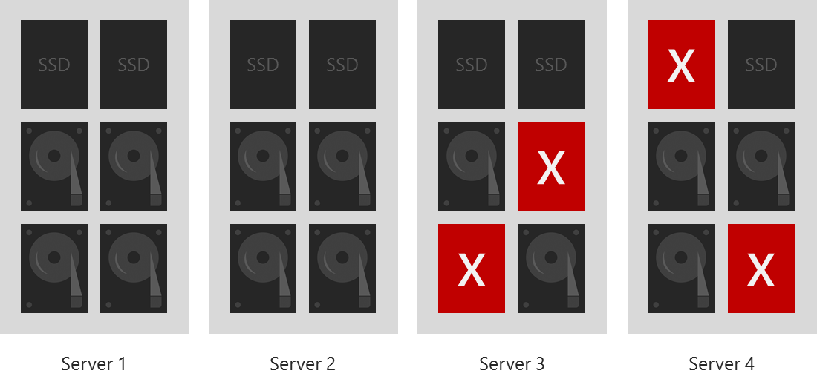
Survival examples

Slide 41
Azure Stack Hub scale unit resiliency
Switch resiliency
A single TOR or Aggregate switch can fail
Server resiliency
A single Server node can fail, as long as disk failures are limited to one other Server node
A third Server node down or failed disks in a third Server node will take the affected virtual disks offline
Disk resiliency
A single disk can fail anywhere in the scale unit
Multiple disks can fail, as long as they are limited to two server nodes
PDU resiliency
A single power supply or PDU can fail with no issues

Slide 42
Questions?

Slide 44
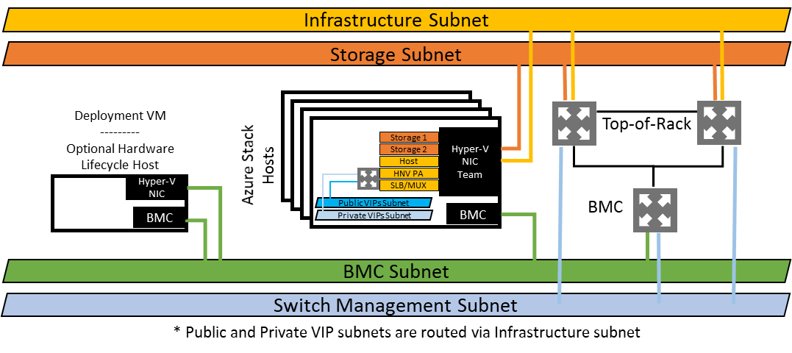
Logical network diagram

